Slide 1

AI-Driven Transition Management & Risk Tracking Agent
Advanced artificial intelligence optimizing change and risk monitoring
Notes:
---

Slide 2
Introduction and Agenda
Notes:
Agenda Overview

Slide 3

Agenda Overview
AI-Driven Transition Management
  The agenda introduces AI-based methods to improve transition management and risk tracking processes effectively.
Objectives and Solutions
  Key objectives include implementing AI to enhance transition efficiency and presenting an overview of the AI solution.
Risk Management Strategies
  Focus on proactive risk management strategies enabled by AI to minimize potential issues during transitions.
Benefits and Next Steps
  Emphasizes benefits of adopting AI and outlines implementation steps for stakeholders to follow.
Notes:
The agenda for this presentation sets the stage for understanding the AI-driven approach to transition management and risk tracking. It includes an introduction to the concept, objectives of implementing AI in transition processes, a solution overview, key features of the proposed system, risk management strategies, and the benefits of adopting this approach. Finally, it outlines next steps for implementation. This structured agenda ensures that stakeholders gain a comprehensive understanding of how AI can transform traditional transition management practices into proactive, data-driven processes that minimize risks and enhance efficiency.

Slide 4
Current Challenges
Notes:
Challenges in Transition Management

Slide 5

Challenges in Transition Management
Manual Risk Tracking Issues
  Manual risk tracking causes delayed escalations and restricts visibility into project progress, increasing risk exposure.
Dependency Challenges
  Dependence on SME availability and client feedback complicates transition management and causes potential delays.
Data Quality Impact
  Poor input data quality undermines decision-making, causing inefficiencies and increasing project risks.
AI-Driven Solutions
  Automated AI solutions offer real-time insights, predictive analytics, and streamlined stakeholder communication.
Notes:
Organizations face several challenges during transition phases, including manual risk tracking that often leads to delayed escalations and limited visibility into progress. Dependencies on SME availability and timely client feedback further complicate the process, while poor input data quality can undermine decision-making. These issues result in inefficiencies, increased risk exposure, and potential delays in project timelines. Addressing these challenges requires a robust, automated solution that leverages AI to provide real-time insights, predictive analytics, and streamlined communication among stakeholders.

Slide 6
Objectives
Notes:
Goals of AI Integration

Slide 7

Goals of AI Integration
Automated Tracking
  AI automates tracking processes, significantly reducing manual effort and increasing accuracy in transition management.
Proactive Risk Management
  AI predicts and mitigates risks proactively, helping organizations avoid potential issues before they arise.
Enhanced Stakeholder Engagement
  Transparent reporting powered by AI improves stakeholder communication and engagement throughout transitions.
Governance and Compliance
  AI ensures timely reviews and compliance with governance standards, maintaining organizational accountability.
Notes:
The primary objectives of integrating AI into transition management include automating tracking processes to reduce manual effort, predicting and mitigating risks proactively, and improving stakeholder engagement through transparent reporting. Additionally, the system aims to ensure timely reviews and compliance with governance standards. By achieving these goals, organizations can enhance operational efficiency, reduce risk exposure, and foster a culture of accountability and responsiveness throughout the transition lifecycle.

Slide 8
Solution Overview
Notes:
AI Agent Capabilities

Slide 9

AI Agent Capabilities
Milestone Monitoring
  The AI solution continuously monitors key project milestones to ensure timely progress and alignment with goals.
Risk and Dependency Tracking
  It tracks potential risks and dependencies, helping to identify challenges early and mitigate them proactively.
Predictive Alerts
  The system provides predictive alerts to prevent issues from escalating, enhancing proactive decision-making.
Dashboards and Reporting
  Comprehensive dashboards and reports allow stakeholders to quickly access insights and make informed decisions.
Notes:
The proposed AI-driven solution offers a range of capabilities designed to streamline transition management. It monitors milestones, tracks risks and dependencies, and provides predictive alerts to prevent potential issues before they escalate. The system also generates comprehensive dashboards and reports, enabling stakeholders to make informed decisions quickly. By leveraging AI Foundry LLMs and advanced analytics, the solution ensures that transition processes are not only efficient but also resilient to unforeseen challenges.

Slide 10
Architecture
Notes:
System Architecture and Workflow

Slide 11

System Architecture and Workflow
System Components
  The system includes AI Foundry LLM, data ingestion, risk scoring engine, and visualization dashboard for efficient management.
Data Ingestion and Validation
  Data collection is validated through the ingestion layer to ensure high-quality input for accurate risk assessment.
Risk Scoring and Insights
  Risk scoring engine assesses potential threats and generates actionable risk insights for decision-making.
Visualization and Communication
  Insights are delivered to stakeholders through real-time, intuitive dashboards for timely interventions.
Notes:
The architecture of the AI-driven transition management system comprises several key components: an AI Foundry LLM for intelligent insights, a data ingestion layer for validating input quality, a risk scoring engine for assessing potential threats, and a visualization dashboard for real-time monitoring. The workflow begins with data collection, which is processed by the AI agent to generate actionable risk insights. These insights are then communicated to stakeholders through intuitive dashboards, ensuring timely interventions and informed decision-making.

Slide 12
Risk Tracking Features
Notes:
Capabilities for Risk Management

Slide 13
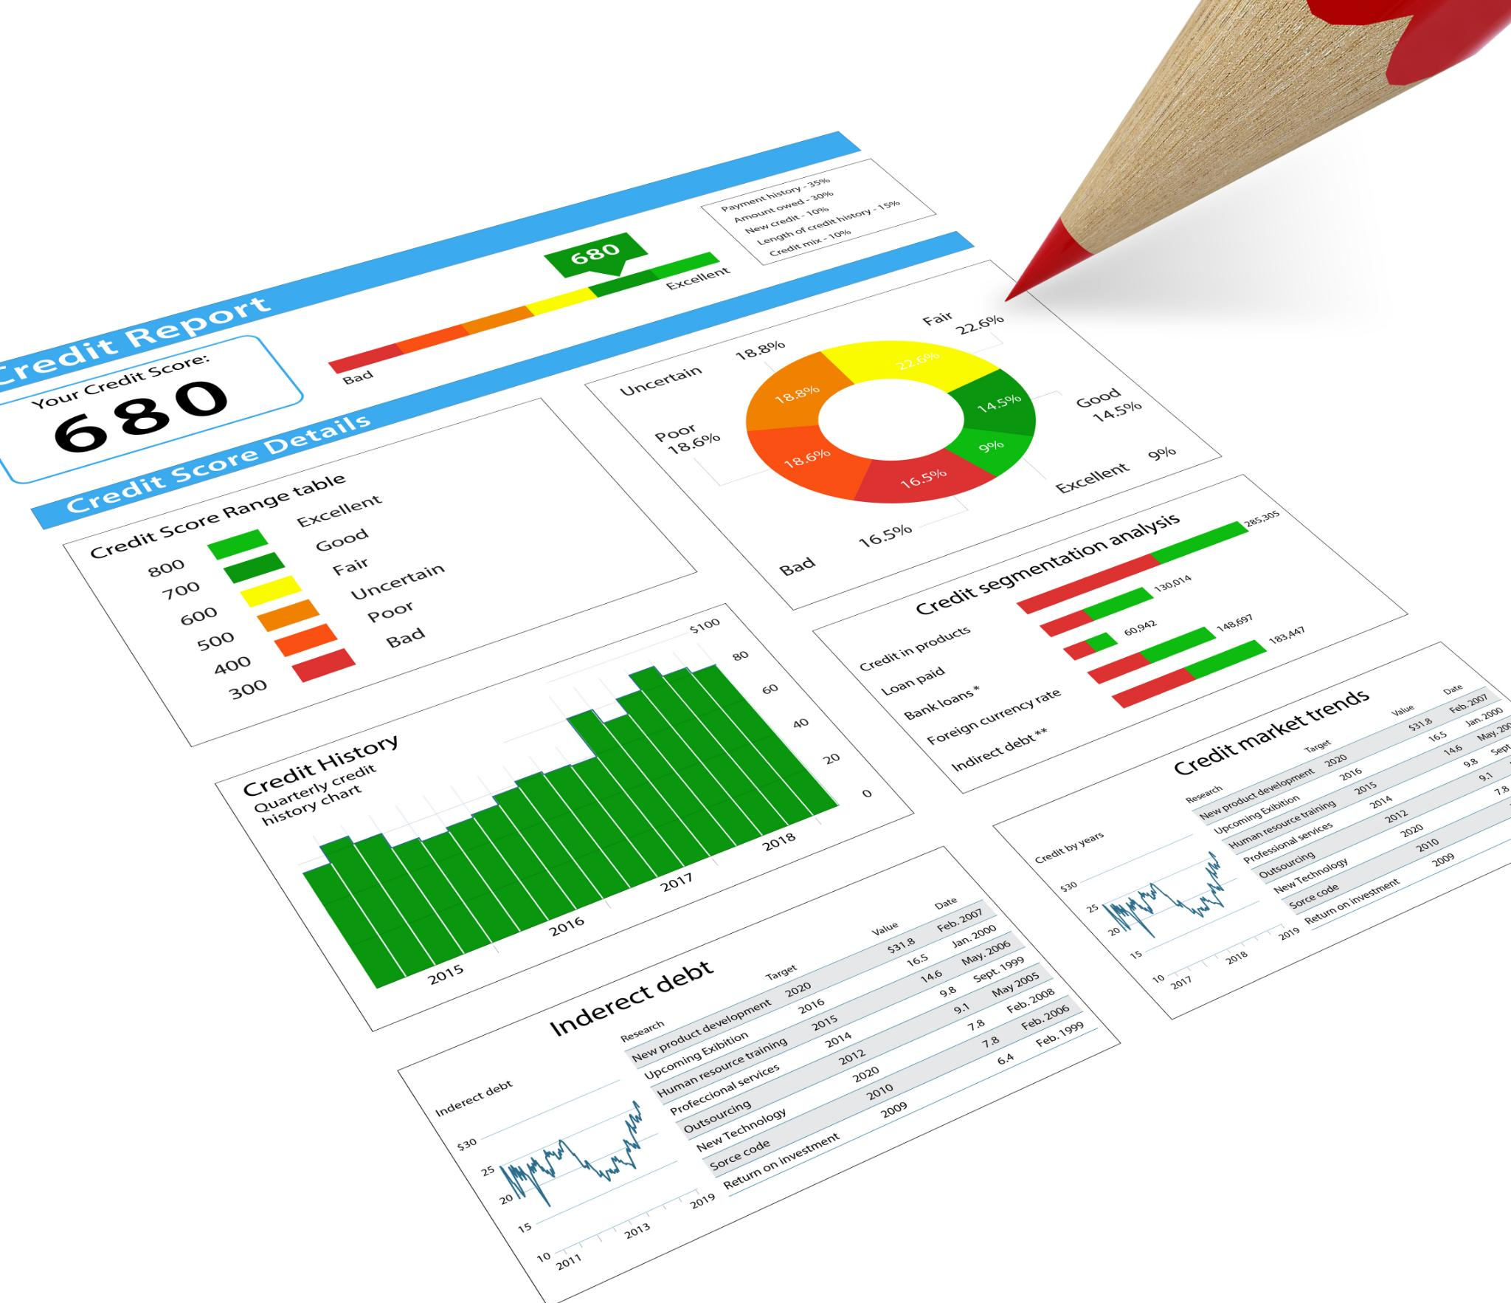
Capabilities for Risk Management
Real-Time Issue Identification
  The system detects potential risks immediately, allowing quick responses to emerging issues.
Automated Escalation Workflows
  Automated processes ensure timely escalation of risks to appropriate teams for resolution.
Predictive Risk Analytics
  Analytics forecast risk trends, enabling proactive measures to prevent issues before they occur.
Integration with Project Tools
  Seamless integration with project management systems enhances risk tracking and coordination.
Notes:
The risk tracking module offers real-time identification of potential issues, automated escalation workflows to ensure timely resolution, and seamless integration with existing project management tools. Predictive analytics enable the system to forecast risk trends, allowing organizations to take preventive measures before problems arise. These features collectively enhance the organization's ability to manage risks proactively, reducing the likelihood of delays and cost overruns during transitions.

Slide 14
Transition Management Features
Notes:
Capabilities for Transition Oversight

Slide 15

Capabilities for Transition Oversight
Stakeholder Coordination
  Tracks stakeholder availability and sends timely review reminders to enhance coordination and engagement.
Knowledge Repository
  Maintains a centralized knowledge repository for SMEs to ensure continuity through transition phases.
Automated Compliance
  Automates compliance checklists to reduce manual effort and minimize errors during transitions.
Notes:
The transition management module focuses on improving stakeholder coordination and process efficiency. It tracks stakeholder availability, sends timely review reminders, and maintains a knowledge repository for SMEs to ensure continuity. Additionally, it automates compliance checklists, reducing manual effort and minimizing errors. These features enable organizations to manage transitions smoothly, even in complex environments with multiple dependencies and tight timelines.

Slide 16
Benefits
Notes:
Advantages of AI-Driven Approach

Slide 17
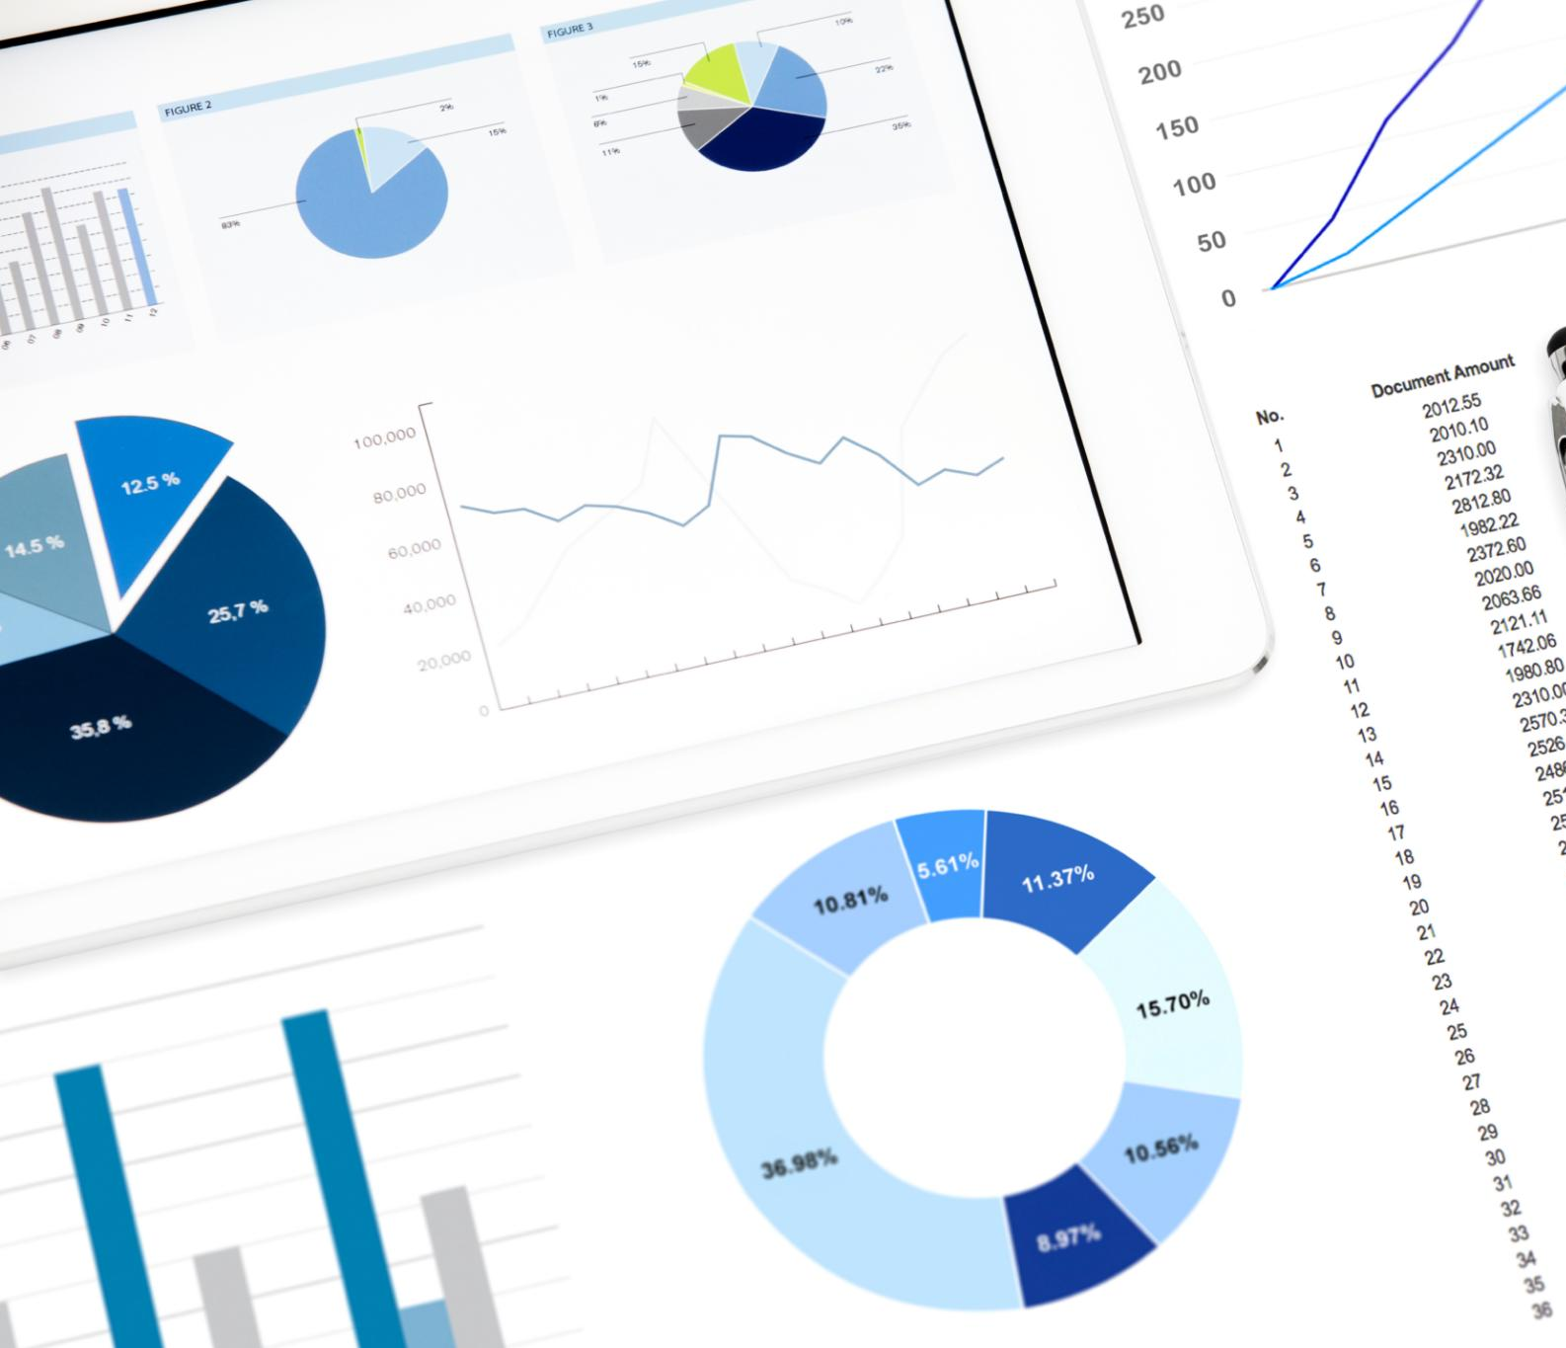
Advantages of AI-Driven Approach
Automation Reduces Delays
  AI automates routine tasks and provides predictive alerts to minimize project delays effectively.
Risk and Progress Visibility
  Enhanced visibility into risks and project progress improves monitoring and proactive responses.
Transparent Client Reporting
  Transparent reporting increases client confidence through clear and accessible project updates.
Data-Driven Decision Making
  Decisions are backed by accurate data insights, leading to better project outcomes and reduced costs.
Notes:
Implementing an AI-driven transition management and risk tracking system offers numerous benefits. It reduces delays by automating routine tasks and providing predictive alerts, improves visibility into risks and progress, and enhances client confidence through transparent reporting. Furthermore, it enables data-driven decision-making, ensuring that every action is backed by accurate insights. These advantages collectively contribute to higher efficiency, reduced costs, and improved project outcomes.

Slide 18
Next Steps
Notes:
Implementation Roadmap

Slide 19

Implementation Roadmap
Finalize System Architecture
  Complete the design of the AI system architecture and define access requirements for secure implementation.
Conduct Pilot Program
  Run a pilot with selected transitions to validate functionality and gather real-world feedback for improvements.
Scale Across Programs
  Expand the AI-driven solution to multiple programs ensuring scalability and robust performance.
Notes:
The next steps for implementing the AI-driven solution include finalizing the system architecture and access requirements, conducting a pilot program with selected transitions to validate functionality, and scaling the solution across multiple programs. These steps will ensure a smooth rollout and allow for iterative improvements based on real-world feedback, ultimately leading to a robust and scalable transition management framework.

